Slide 1
RingSFL: An Adaptive Split Federated Learning
Towards Taming Client Heterogeneity
▶ 汇报时间：2022.10.23
▶ 汇报人：沈京龙

Slide 2
目 录
壹 | Background | 03
贰 | RingSFL | 09
叁 | Evaluation | 35
CONTENT

Slide 3
1
Part One
Background

Slide 4
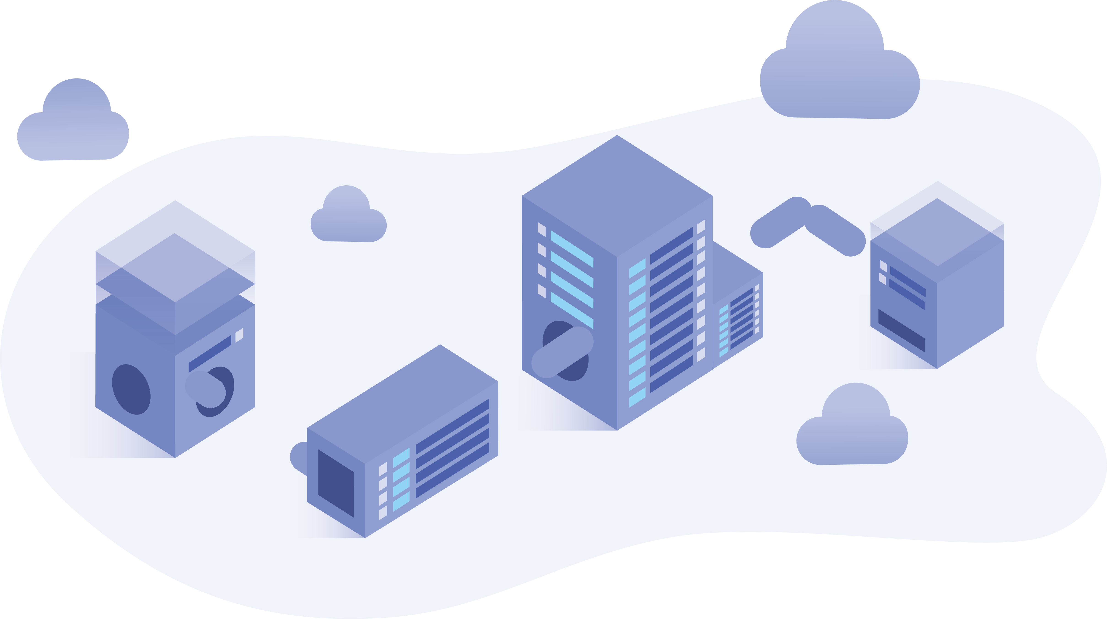








What is Federated Learning？
Background
RingSFL
Evaluation
-
Centralized Learning
Each client upload its local datasets to cloud for centralized training.
Cloud
Centralized training at the server.
Weakness
Upload datasets
1. Unacceptable communication burden.
2. Compromising user privacy.
3. Wasting of computational power.
Client 0
Client 1
Client N-1
Client N

Slide 5
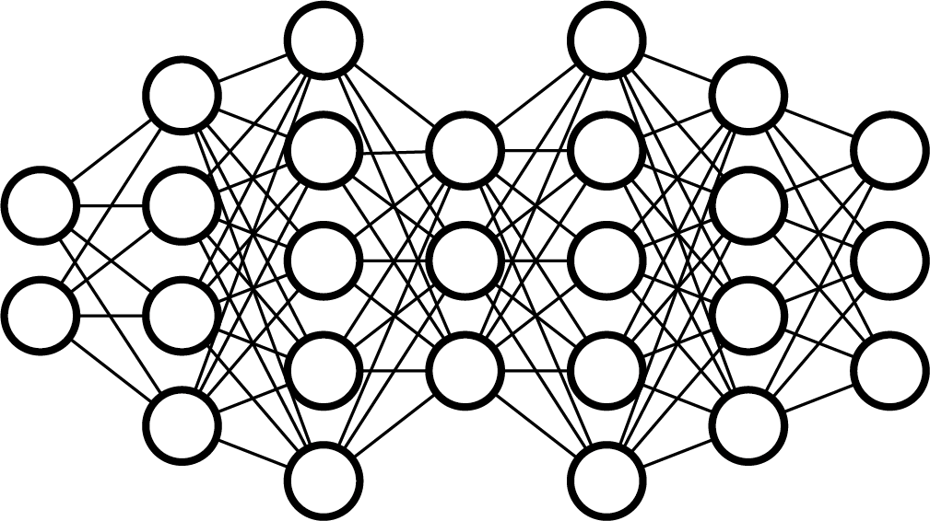
What is Federated Learning？
Background
RingSFL
Evaluation
-
Federated Learning
Training at each clients，upload trained model parameters instead.
Cloud
Model aggregation.
Training Process
Cloud distribute initialized global model.
Each client conducts training using their local datasets.
Each client uploads trained local model to cloud for aggregation.
Cloud distribute aggregated model.
Repeat step 2 – 4 until converge.
Upload local models
Client 0
Client 1
Client N-1
Client N
Localized training at the network edge.
B. McMahan, E. Moore, D. Ramage, S. Hampson, and B. A. y. Arcas, “Communication-Efficient Learning of Deep Networks from Decentralized Data,” in Proc. International Conference on Artificial Intelligence and Statistics, 2017, pp. 1273–1282.

Slide 6
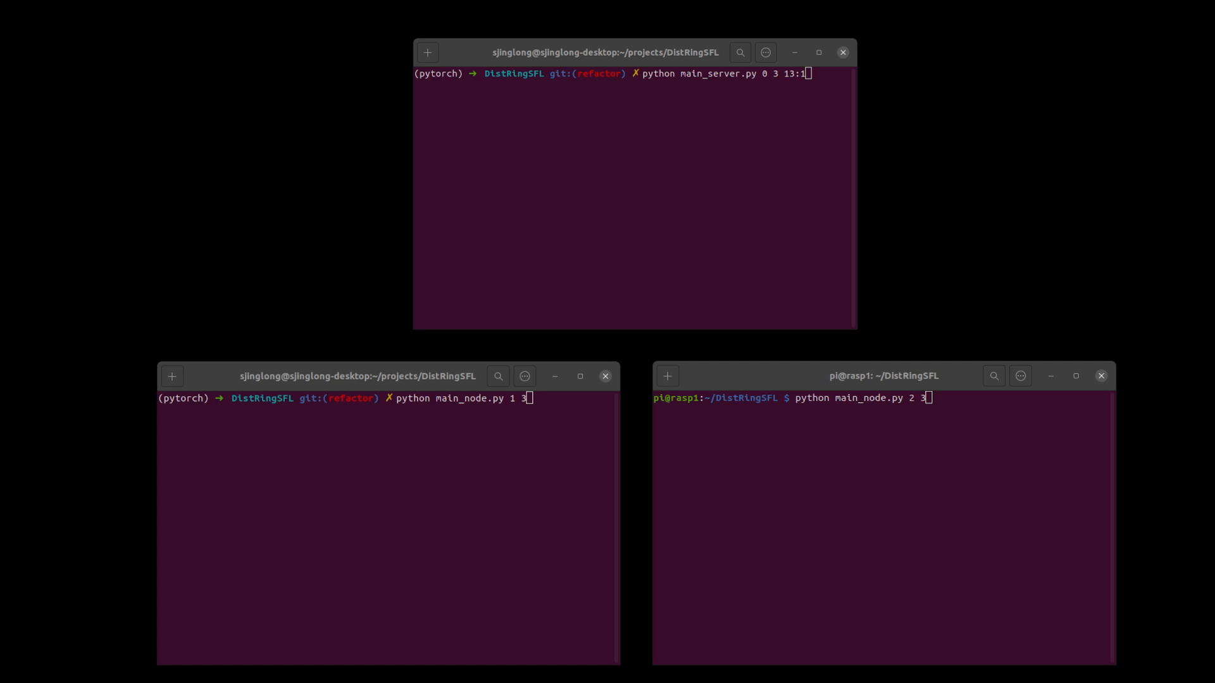
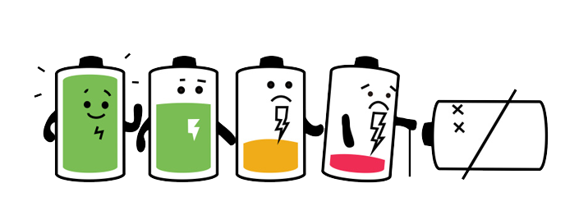
Challenge: Client Heterogeneity
Background
RingSFL
Evaluation
-
The clients in the FL system may differ significantly in terms of computational capability and battery level.
Straggler Effect
Battery Exhaustion

Slide 7
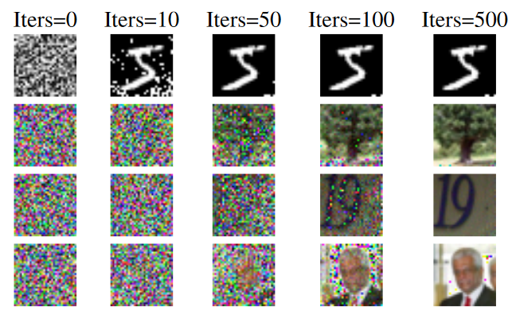
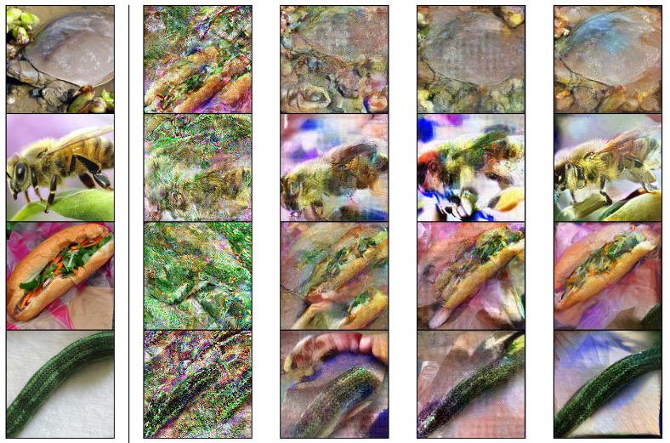
Challenge: Privacy Leakage
Background
RingSFL
Evaluation
-
Sensitive information can still be revealed from model parameters/gradients by a third-party entity or the server.
L. Zhu, Z. Liu, and S. Han, “Deep Leakage from Gradients,” in Proc. Advances in Neural Information Processing Systems, 2019, pp. 1–11.
H. Yin, A. Mallya, A. Vahdat, J. M. Alvarez, J. Kautz, and P. Molchanov, “See Through Gradients: Image Batch Recovery via GradInversion,” in Proc. IEEE/CVF Conference on Computer Vision and Pattern Recognition, 2021, pp. 16 337–16 346.

Slide 8
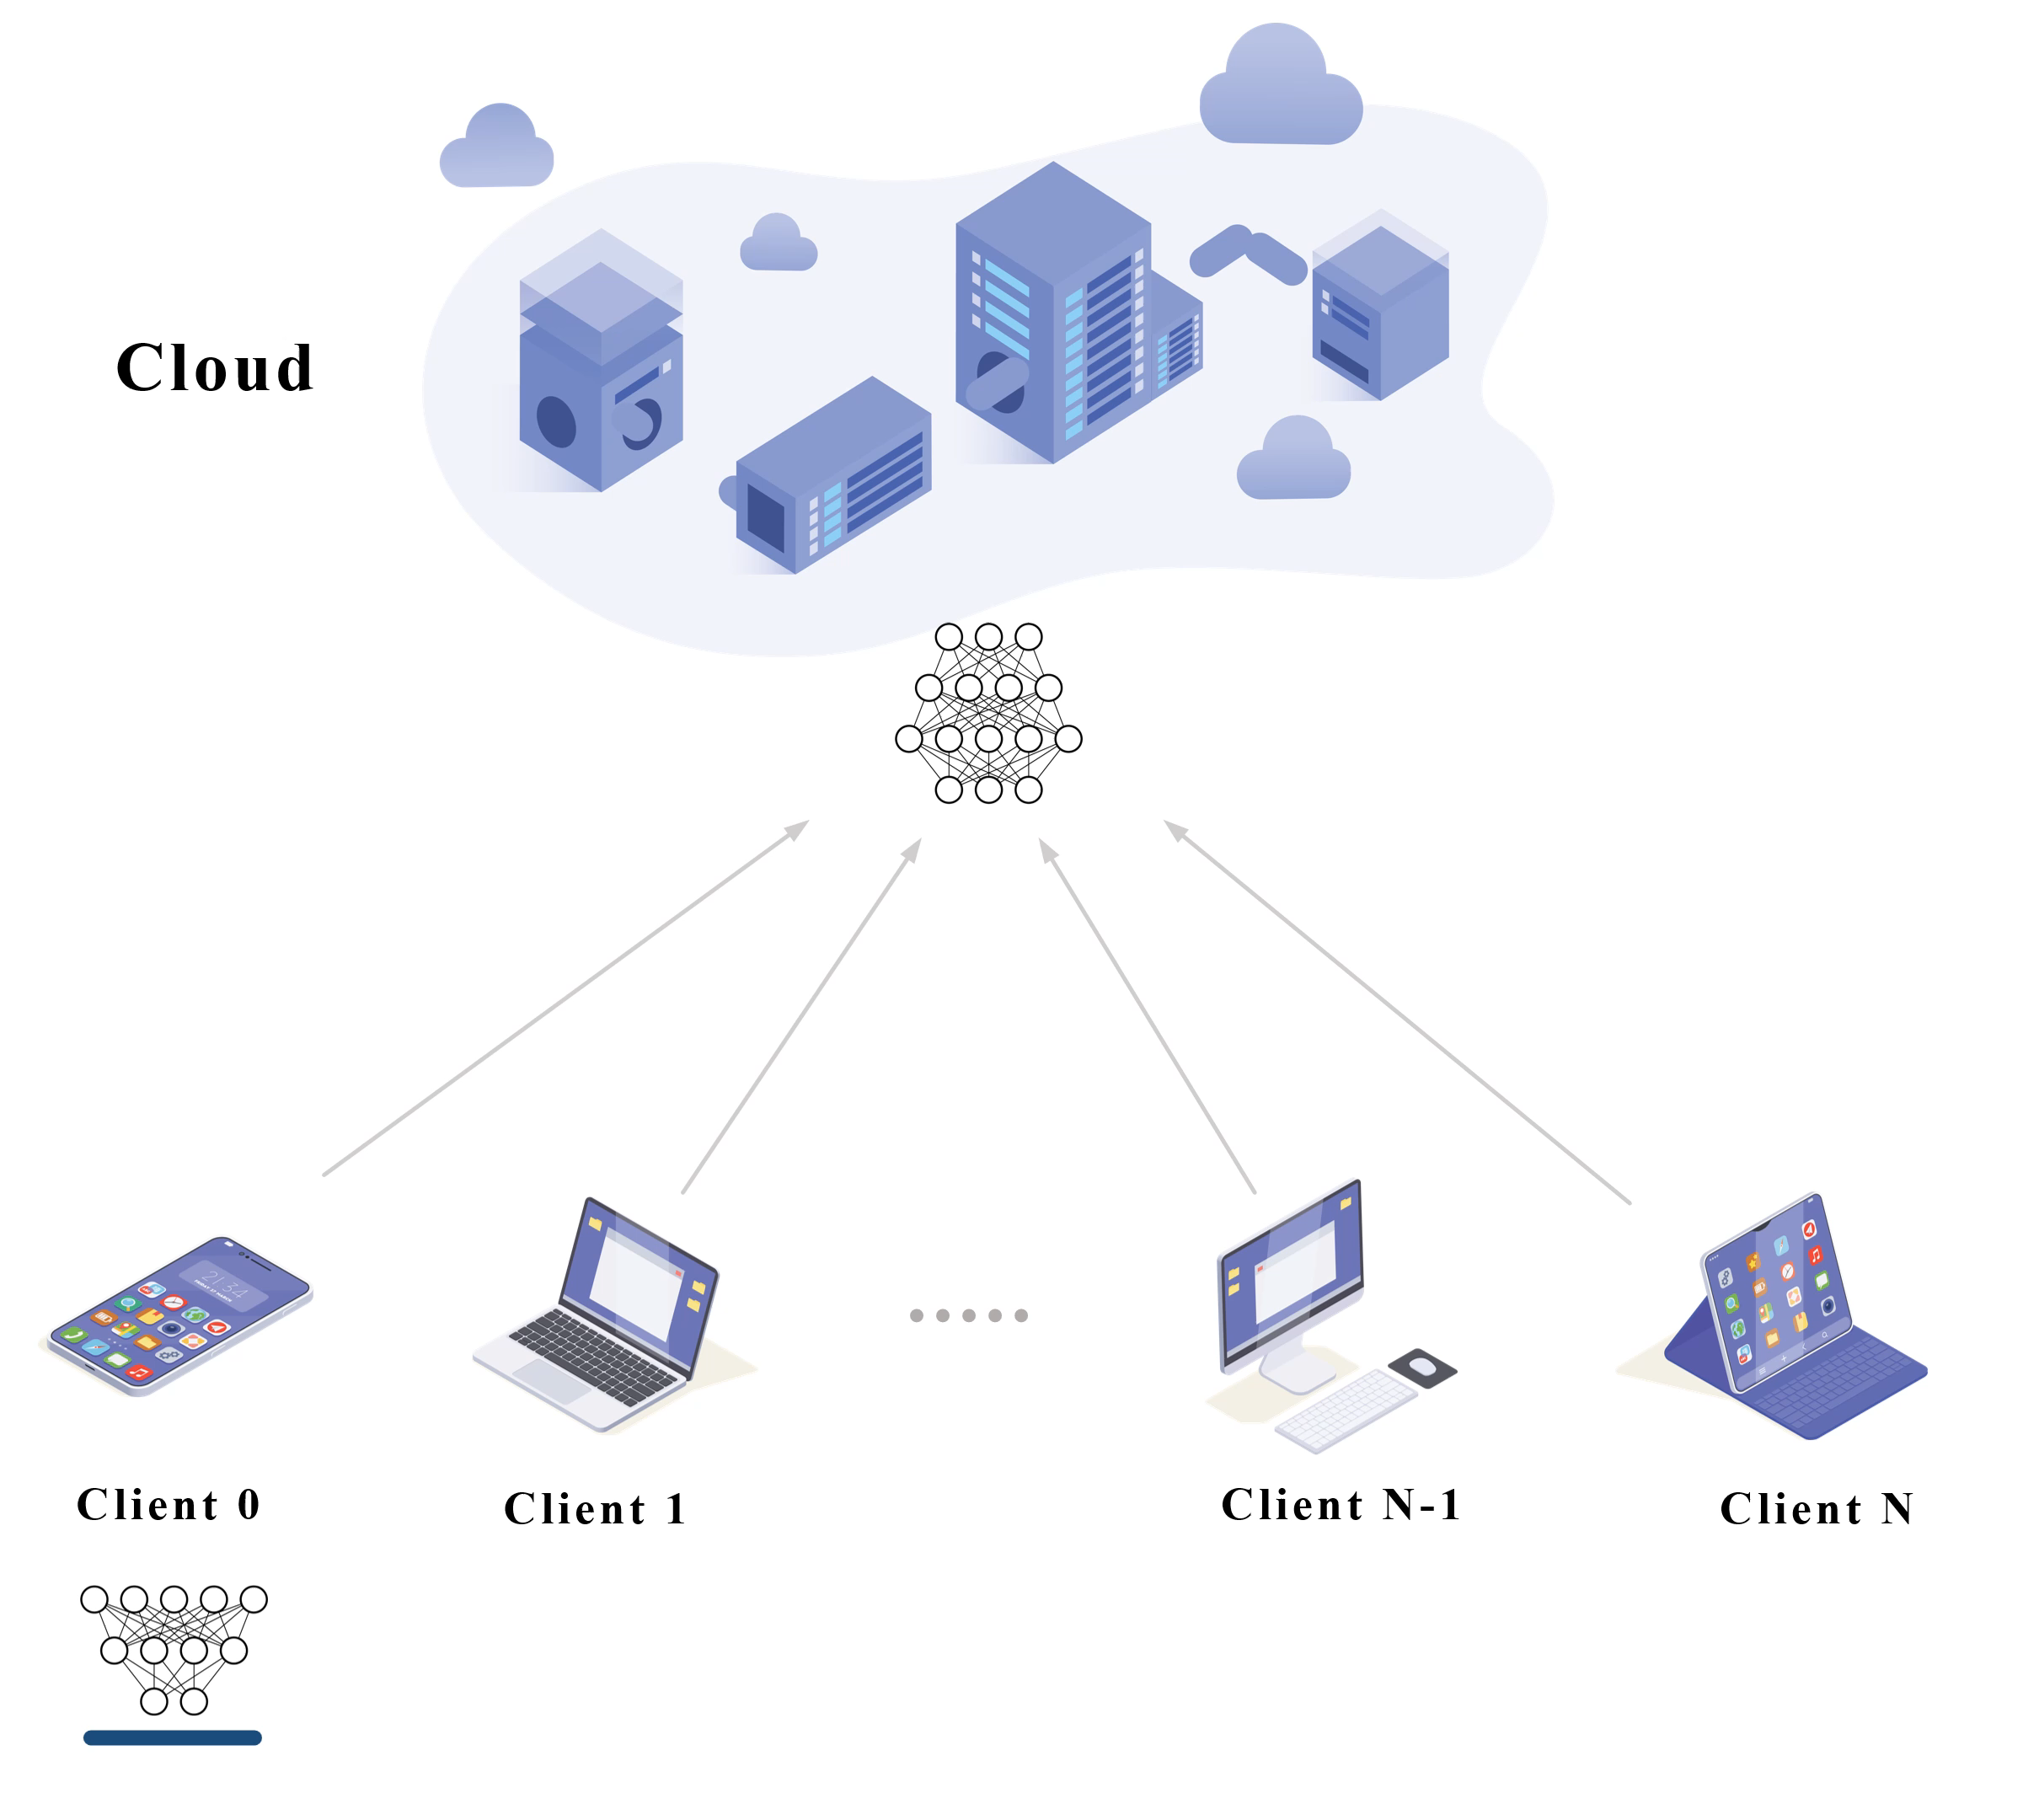
What is Split Learning?
Background
RingSFL
Evaluation
-
Advantage
Lower client computation load.
Improved security.
Weakness
Cannot parallelize.
O. Gupta and R. Raskar, “Distributed learning of deep neural network over multiple agents,” Journal of Network and Computer Applications, vol. 116, pp. 1–8, 2018.

Slide 9
2
Part Two
RingSFL

Slide 10
Architecture
Background
RingSFL
Evaluation
-

Slide 11
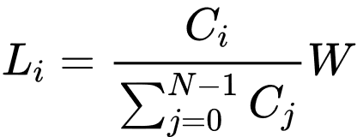
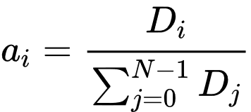
Training Process
Background
RingSFL
Evaluation
-
Initialization
Server distribute initialized global model along with configuration parameters.
Propagation step:
Aggregation weight:

Slide 12
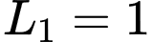
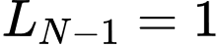
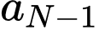
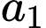
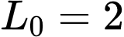
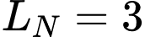
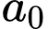
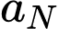
Training Process
Background
RingSFL
Evaluation
-
Initialization
Server distribute initialized global model along with configuration parameters.
Propagation step:
Aggregation weight:

Slide 13
Training Process
Background
RingSFL
Evaluation
-
Forward Propagation
The forward propagation process of each client can be divided into three phases: Starting Phase, Relay Phase, and Stop Phase.
Starting Phase
Clients sample a batch from their respective datasets and enter it into the local model to get the feature map for the relay phase.
Notes:
Parallelly training.

Slide 14
Training Process
Background
RingSFL
Evaluation
-
Forward Propagation
The forward propagation process of each client can be divided into three phases: Starting Phase, Relay Phase, and Stop Phase.
Starting Phase
Clients sample a batch from their respective datasets and enter it into the local model to get the feature map for the relay phase.
Notes:
Parallelly training.

Slide 15
Training Process
Background
RingSFL
Evaluation
-
Forward Propagation
The forward propagation process of each client can be divided into three phases: Starting Phase, Relay Phase, and Stop Phase.
Relay Phase
Clients receive the feature map from the previous node, propagate it forward in the local model and then send it to the next node.
Notes:
Parallelly training.

Slide 16
Training Process
Background
RingSFL
Evaluation
-
Forward Propagation
The forward propagation process of each client can be divided into three phases: Starting Phase, Relay Phase, and Stop Phase.
Relay Phase
Clients receive the feature map from the previous node, propagate it forward in the local model and then send it to the next node.
Notes:
Parallelly training.

Slide 17
Training Process
Background
RingSFL
Evaluation
-
Forward Propagation
The forward propagation process of each client can be divided into three phases: Starting Phase, Relay Phase, and Stop Phase.
Relay Phase
Clients receive the feature map from the previous node, propagate it forward in the local model and then send it to the next node.
Notes:
Parallelly training.

Slide 18
Training Process
Background
RingSFL
Evaluation
-
Forward Propagation
The forward propagation process of each client can be divided into three phases: Starting Phase, Relay Phase, and Stop Phase.
Relay Phase
Clients receive the feature map from the previous node, propagate it forward in the local model and then send it to the next node.
Notes:
Parallelly training.

Slide 19
Training Process
Background
RingSFL
Evaluation
-
Forward Propagation
The forward propagation process of each client can be divided into three phases: Starting Phase, Relay Phase, and Stop Phase.
Relay Phase
Clients receive the feature map from the previous node, propagate it forward in the local model and then send it to the next node.
Notes:
Parallelly training.

Slide 20
Training Process
Background
RingSFL
Evaluation
-
Forward Propagation
The forward propagation process of each client can be divided into three phases: Starting Phase, Relay Phase, and Stop Phase.
Relay Phase
Clients receive the feature map from the previous node, propagate it forward in the local model and then send it to the next node.
Notes:
Parallelly training.

Slide 21
Training Process
Background
RingSFL
Evaluation
-
Forward Propagation
The forward propagation process of each client can be divided into three phases: Starting Phase, Relay Phase, and Stop Phase.
Relay Phase
Clients receive the feature map from the previous node, propagate it forward in the local model and then send it to the next node.
Notes:
Parallelly training.

Slide 22
Training Process
Background
RingSFL
Evaluation
-
Forward Propagation
The forward propagation process of each client can be divided into three phases: Starting Phase, Relay Phase, and Stop Phase.
Stop Phase
When the feature map traverses all the clients, the clients receive their model output. Clients calculate loss values based on model output and local tags for back propagation.
loss value
label
model output
Notes:
Parallelly training.

Slide 23
Training Process
Background
RingSFL
Evaluation
-
Backward Propagation
The backward propagation process is similar to the forward propagation and can be divided into three phases.
Starting Phase
Clients send the loss value to the previous node and start back propagation.
Notes:
Parallelly training.

Slide 24
Training Process
Background
RingSFL
Evaluation
-
Backward Propagation
The backward propagation process is similar to the forward propagation and can be divided into three phases.
Relay Phase
Clients receive the gradients from the next node in the ring, back propagate locally, and pass the gradients of the smashed layer to the previous node in the ring.
Notes:
Parallelly training.

Slide 25
Training Process
Background
RingSFL
Evaluation
-
Backward Propagation
The backward propagation process is similar to the forward propagation and can be divided into three phases.
Relay Phase
Clients receive the gradients from the next node in the ring, back propagate locally, and pass the gradients of the smashed layer to the previous node in the ring.
Notes:
Parallelly training.

Slide 26
Training Process
Background
RingSFL
Evaluation
-
Backward Propagation
The backward propagation process is similar to the forward propagation and can be divided into three phases.
Relay Phase
Clients receive the gradients from the next node in the ring, back propagate locally, and pass the gradients of the smashed layer to the previous node in the ring.
Notes:
Parallelly training.

Slide 27
Training Process
Background
RingSFL
Evaluation
-
Backward Propagation
The backward propagation process is similar to the forward propagation and can be divided into three phases.
Relay Phase
Clients receive the gradients from the next node in the ring, back propagate locally, and pass the gradients of the smashed layer to the previous node in the ring.
Notes:
Parallelly training.

Slide 28
Training Process
Background
RingSFL
Evaluation
-
Backward Propagation
The backward propagation process is similar to the forward propagation and can be divided into three phases.
Relay Phase
Clients receive the gradients from the next node in the ring, back propagate locally, and pass the gradients of the smashed layer to the previous node in the ring.
Notes:
Parallelly training.

Slide 29
Training Process
Background
RingSFL
Evaluation
-
Backward Propagation
The backward propagation process is similar to the forward propagation and can be divided into three phases.
Relay Phase
Clients receive the gradients from the next node in the ring, back propagate locally, and pass the gradients of the smashed layer to the previous node in the ring.
Notes:
Parallelly training.

Slide 30
Training Process
Background
RingSFL
Evaluation
-
Backward Propagation
The backward propagation process is similar to the forward propagation and can be divided into three phases.
Relay Phase
Clients receive the gradients from the next node in the ring, back propagate locally, and pass the gradients of the smashed layer to the previous node in the ring.
Notes:
Parallelly training.

Slide 31
Training Process
Background
RingSFL
Evaluation
-
Backward Propagation
The backward propagation process is similar to the forward propagation and can be divided into three phases.
Stop Phase
Clients use the locally cached model gradient to update the local model.
Notes:
Parallelly training.

Slide 32
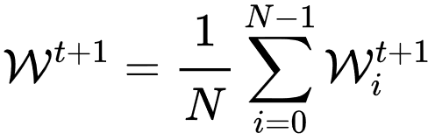
Training Process
Background
RingSFL
Evaluation
-
Model Aggregation
Clients upload locally trained models to the server for aggregation.
Notes:
Parallelly training.

Slide 33
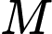

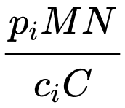
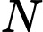
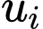
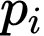
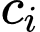
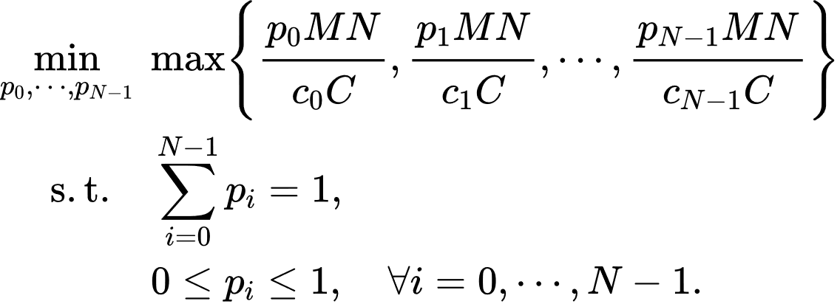
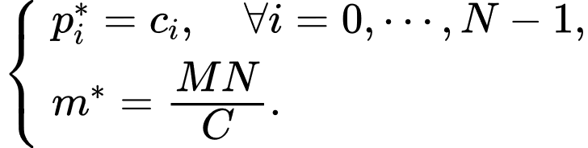
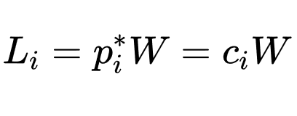
Model Split Scheme
Background
RingSFL
Evaluation
-
完成一个 batch 训练的计算量：
总算力：
客户端数量：
客户端 的计算量占总计算量的比例:
客户端 的算力占总算力的比例：
客户端 的计算耗时：
模型层数
模型的传播步长：
Notes:
Parallelly training.

Slide 34
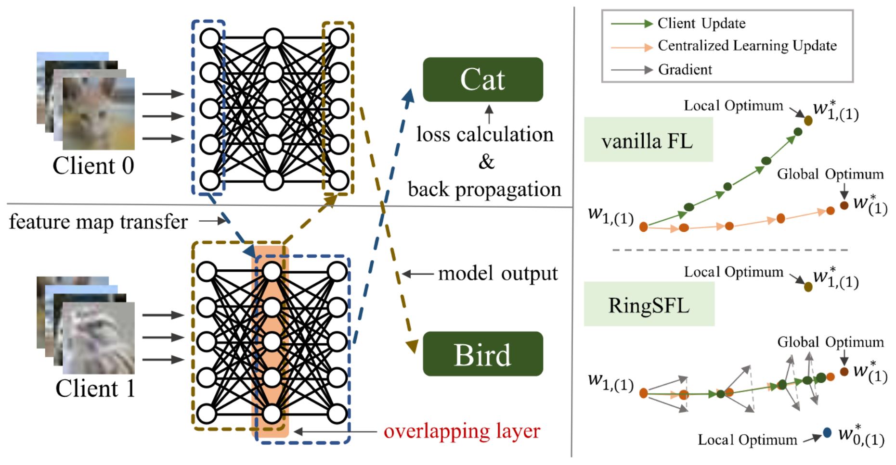
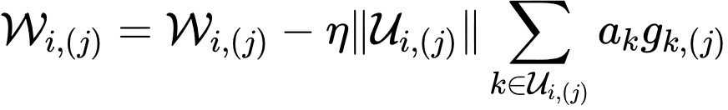
Model Overlapping Layers Can Improve Model Performance
Background
RingSFL
Evaluation
-
Higher aggregation frequency of overlapping layers, leading to more reliable gradient.
Dynamic Learning Rate：
Notes:
Parallelly training.

Slide 35
3
Part Three
Experiment Result

Slide 36
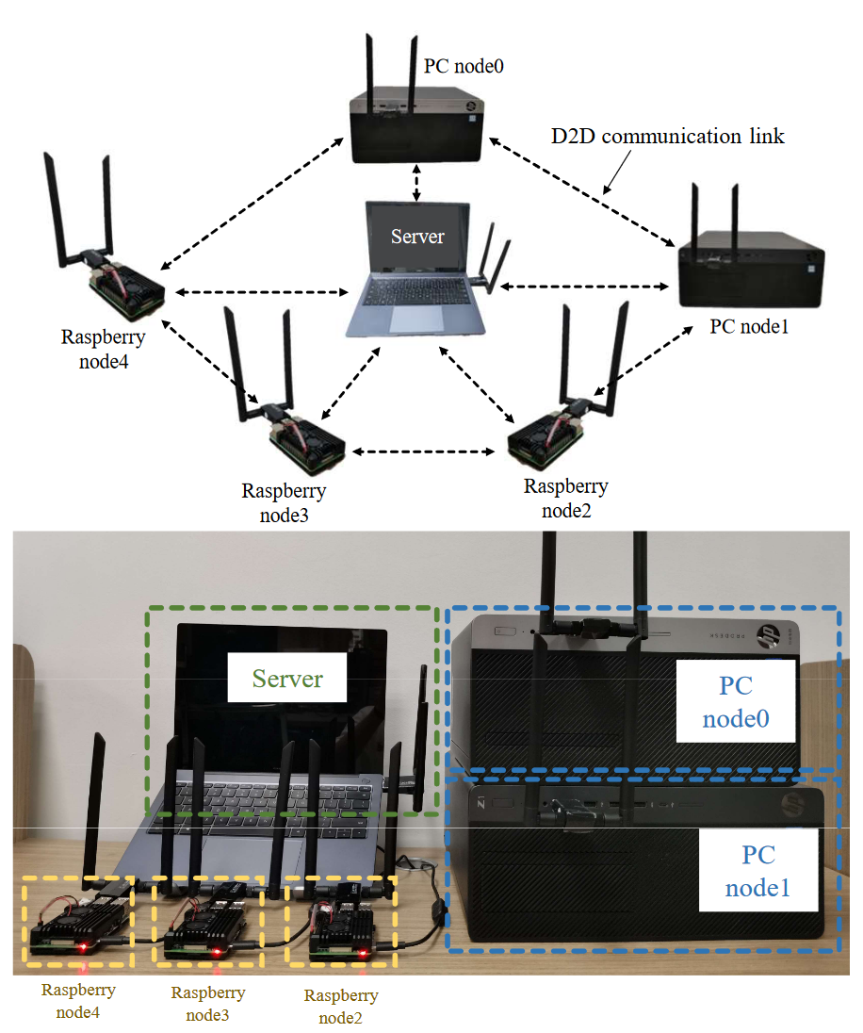
Experimental Setup
Background
RingSFL
Evaluation
-
Platforms
Simulation Environment
Python 3.9.12
Pytorch 1.11.0
Prototype System
ARM Cortex-A72 @ 1.5GHz 6.4W
11th Gen Intel(R) Core(TM) i7-11700 @ 2.50GHz 65W
Central Frequency: 5440MHz
Bandwidth: 40MHz
D2D rate: 135 ± 5.83 Mbps
Notes:
Parallelly training.

Slide 37
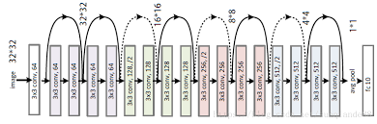
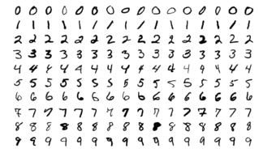
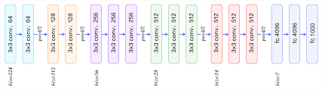
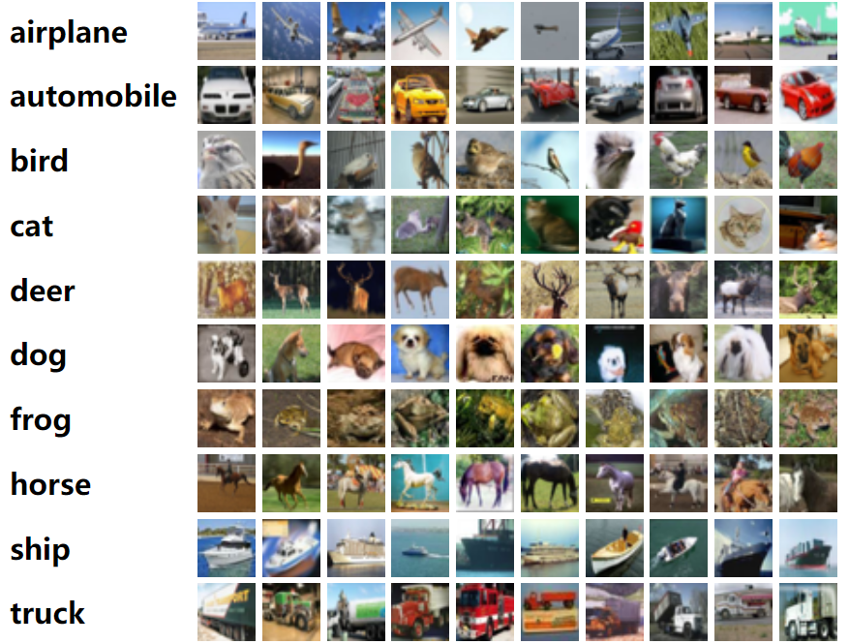
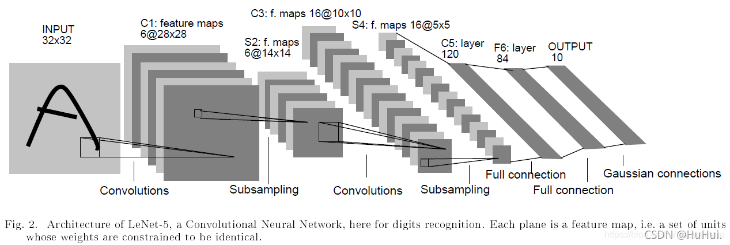
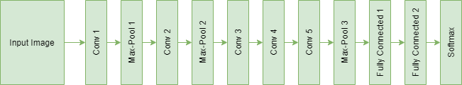
Experimental Setup
Background
RingSFL
Evaluation
-
Datasets and Models
Datasets
Models
ResNet18:
MNIST:
VGG16:
LeNet-5:
CIFAR10:
AlexNet:
Notes:
Parallelly training.

Slide 38
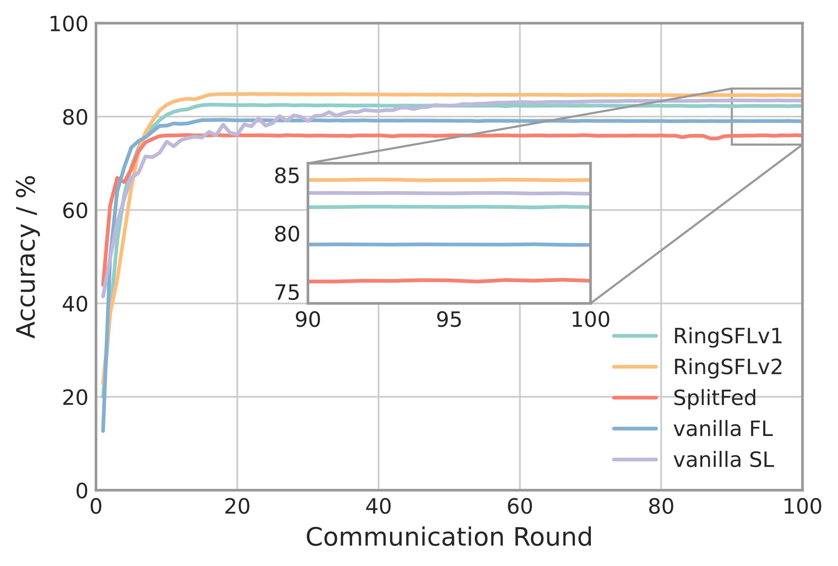
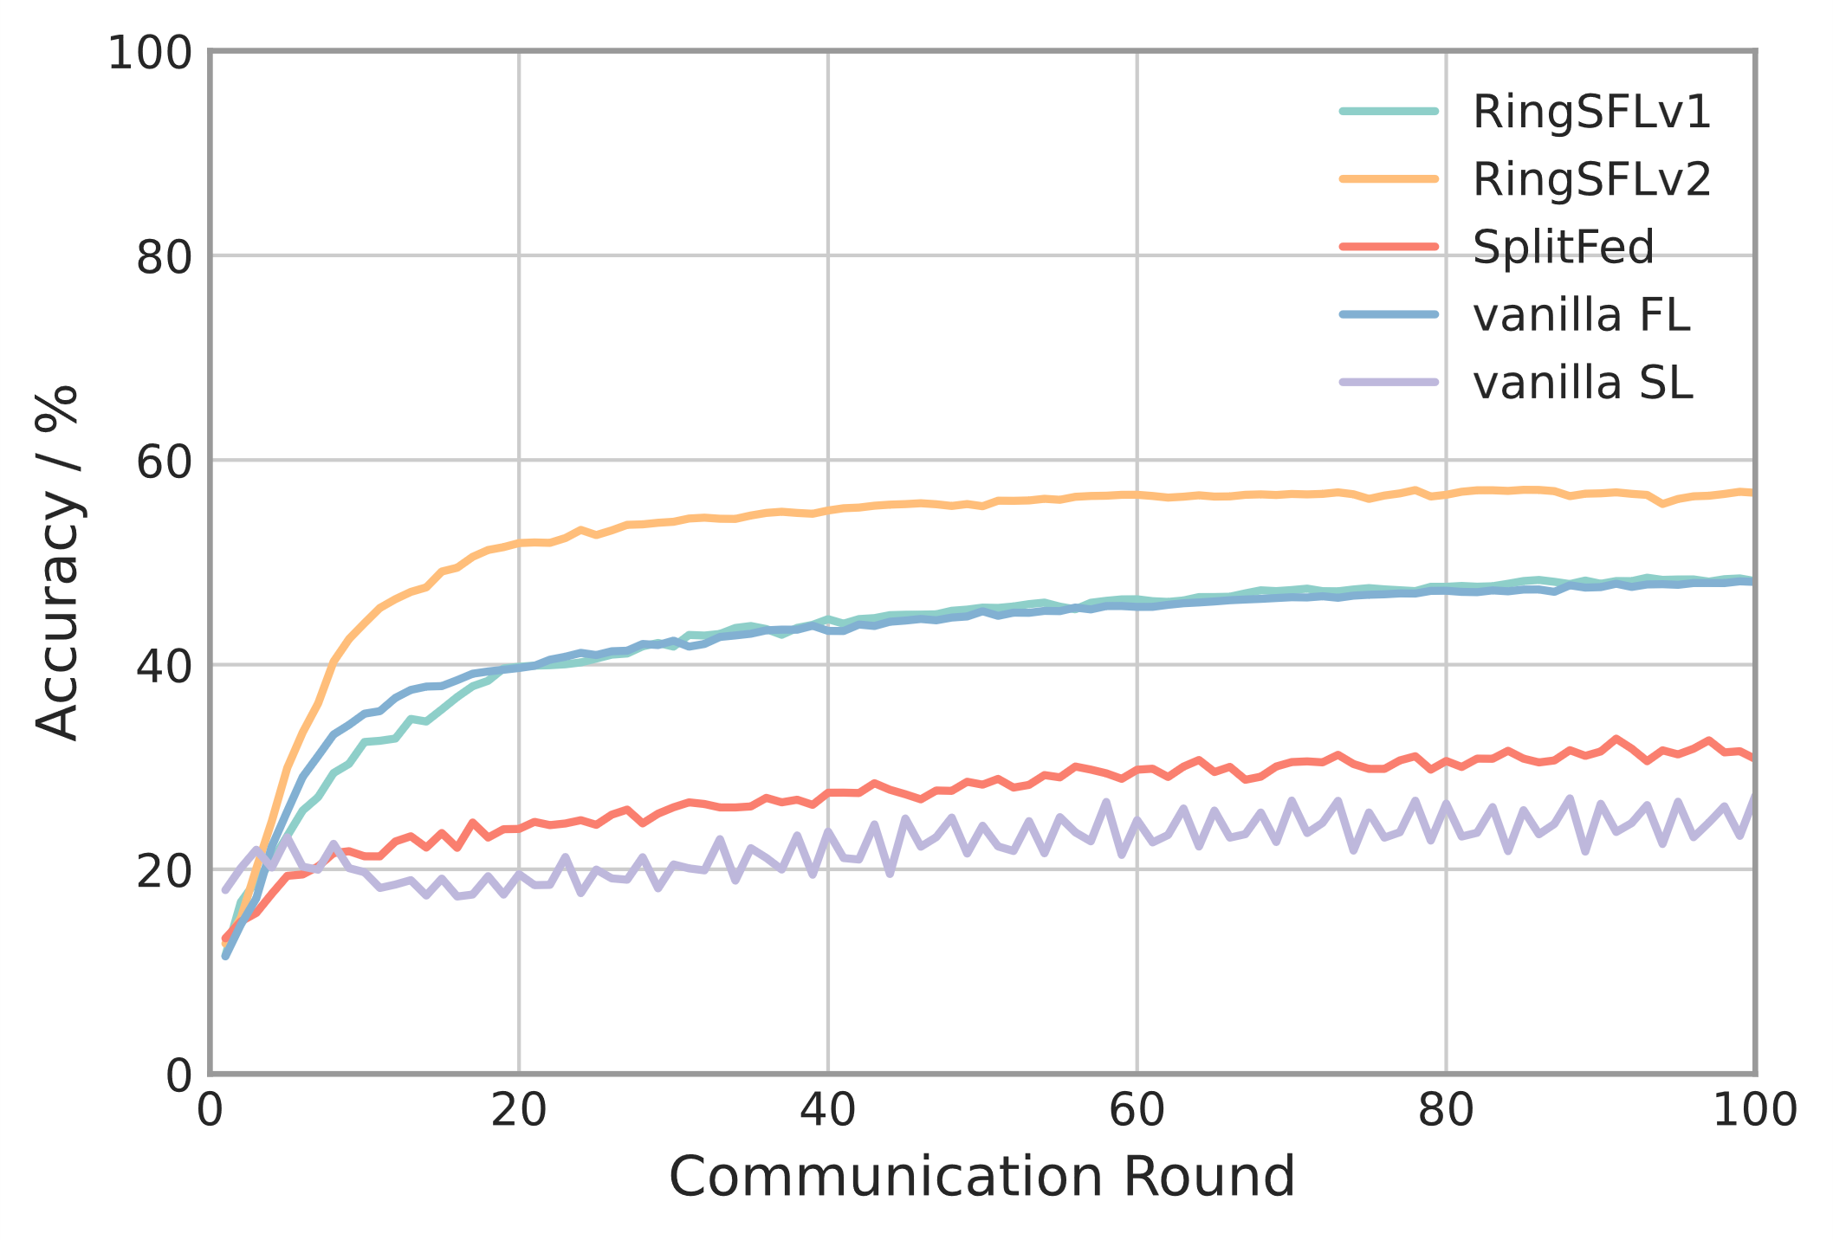
Results and Discussion
Background
RingSFL
Evaluation
-
Convergence Performance
Testing convergence of ResNet18 on Cifar10 under different algorithms.
IID
Non-IID
Notes:
Parallelly training.

Slide 39
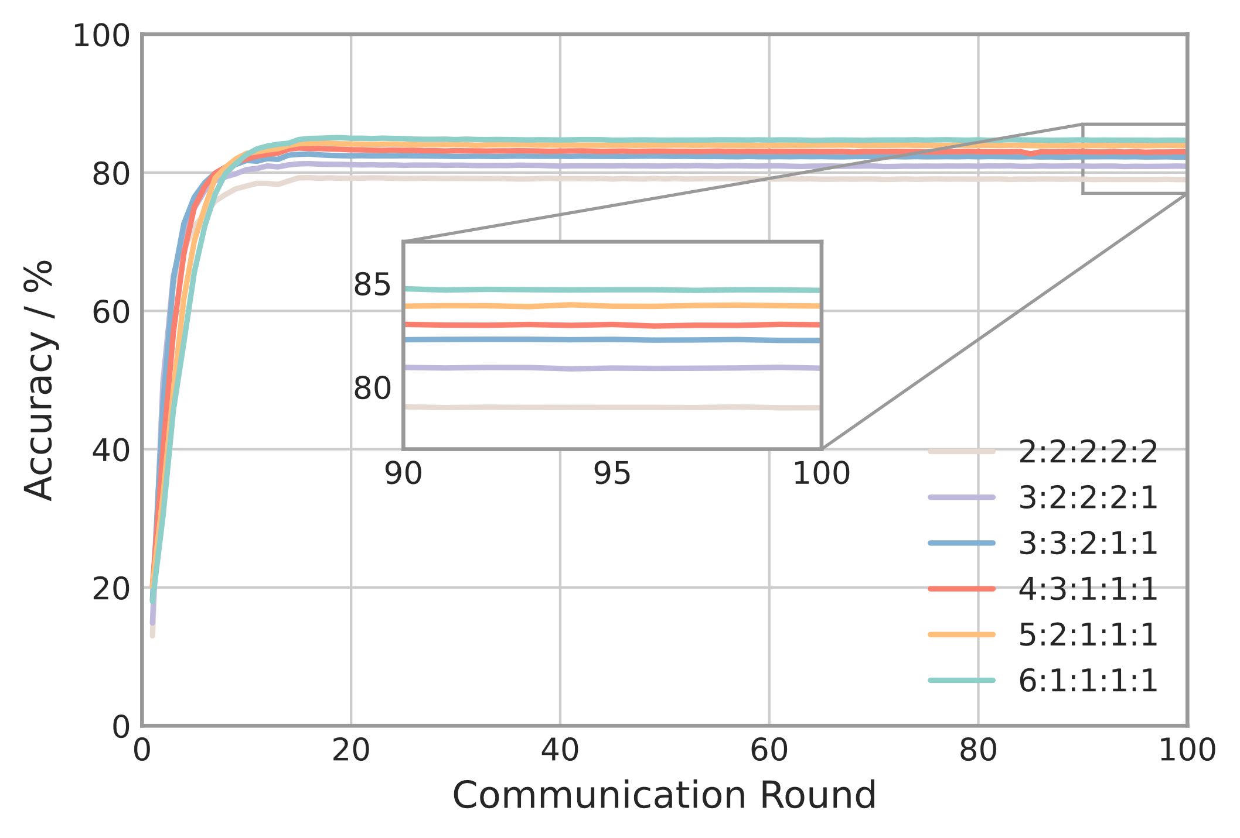
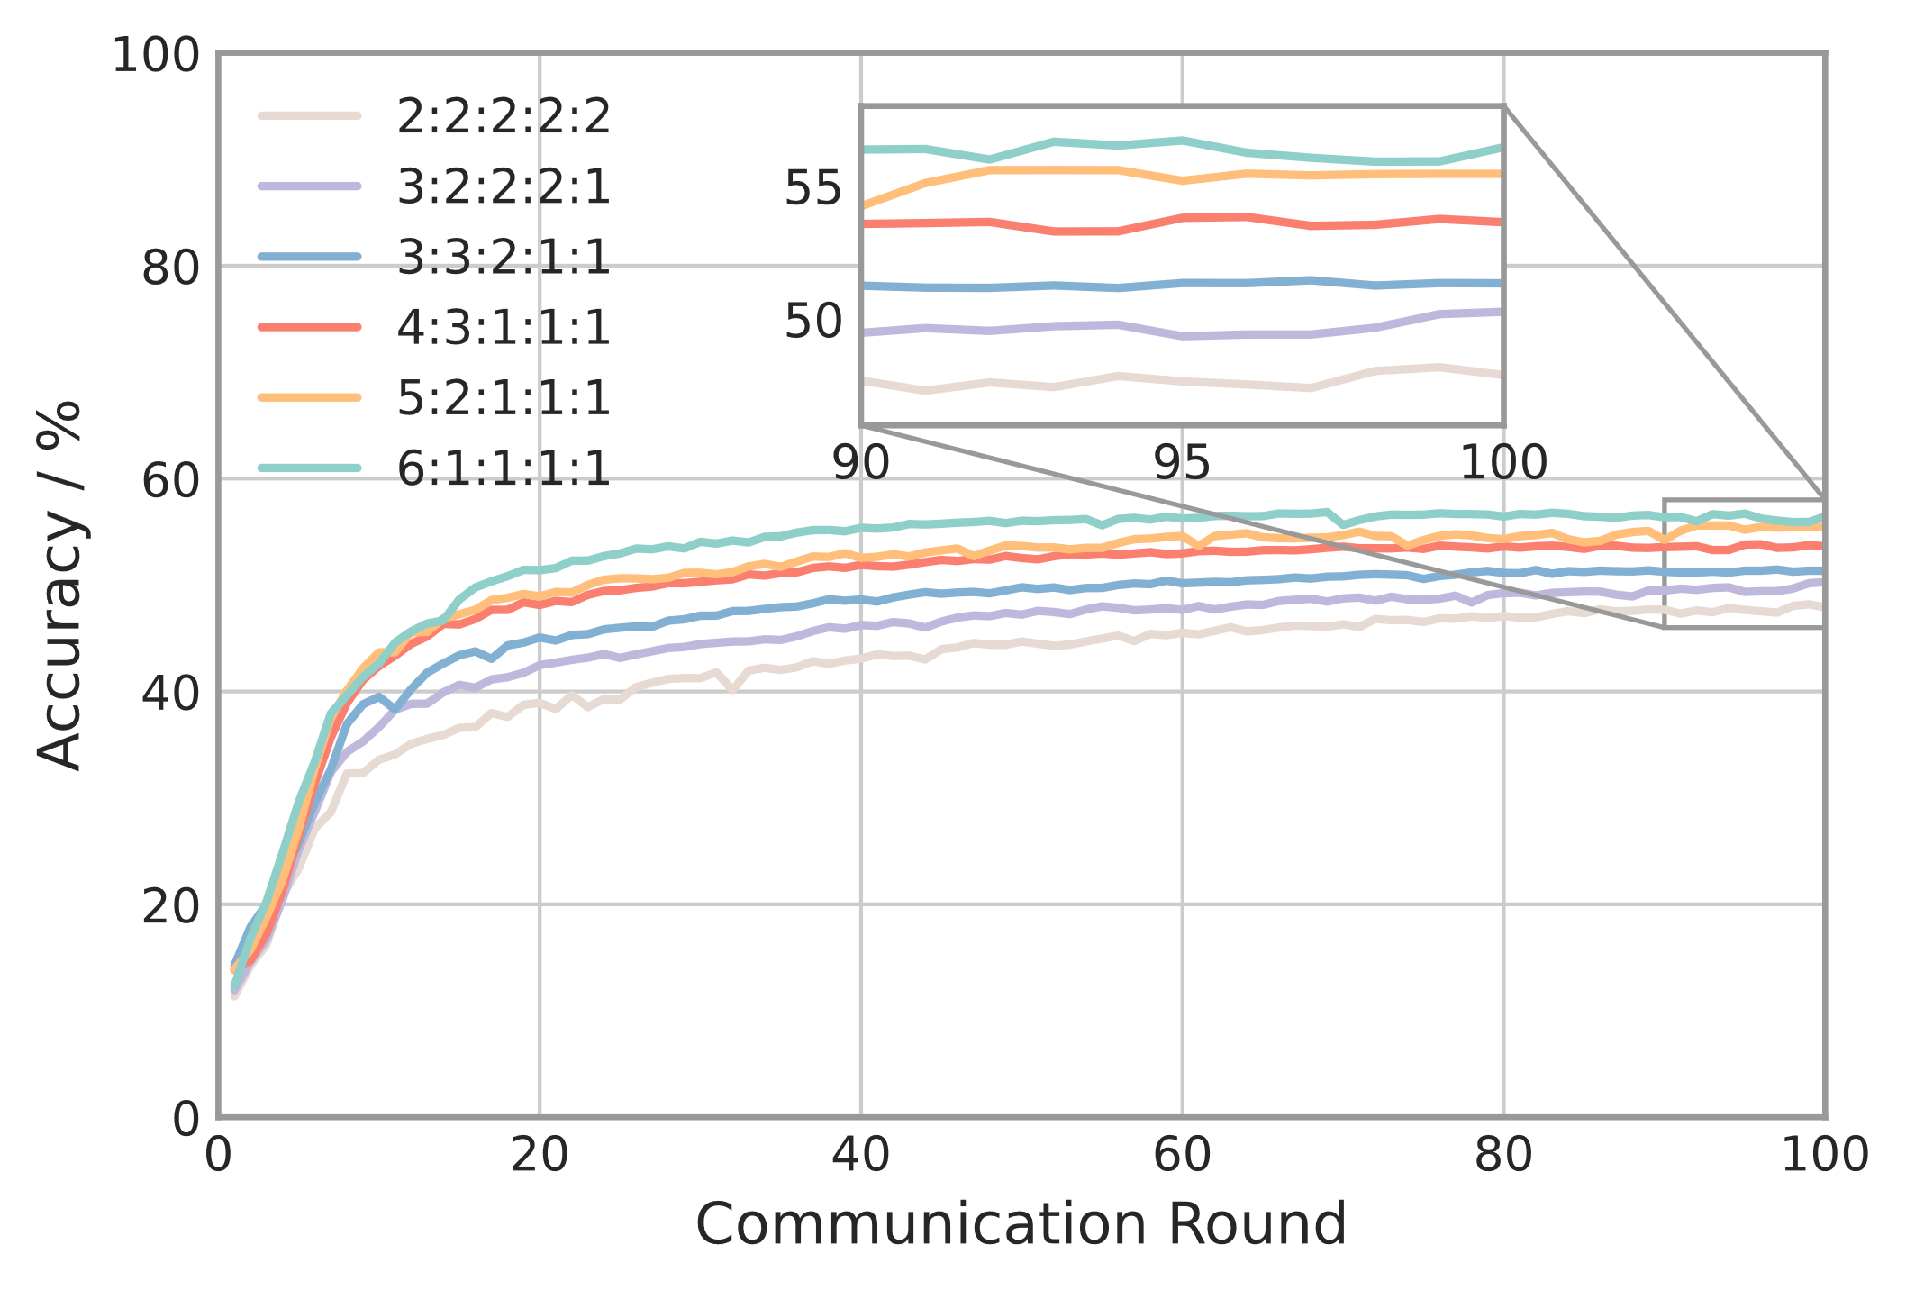
Results and Discussion
Background
RingSFL
Evaluation
-
Effect of Overlapping Layers
Testing convergence of ResNet18 on Cifar10 under different propagation steps.
IID
Non-IID
Notes:
Parallelly training.

Slide 40
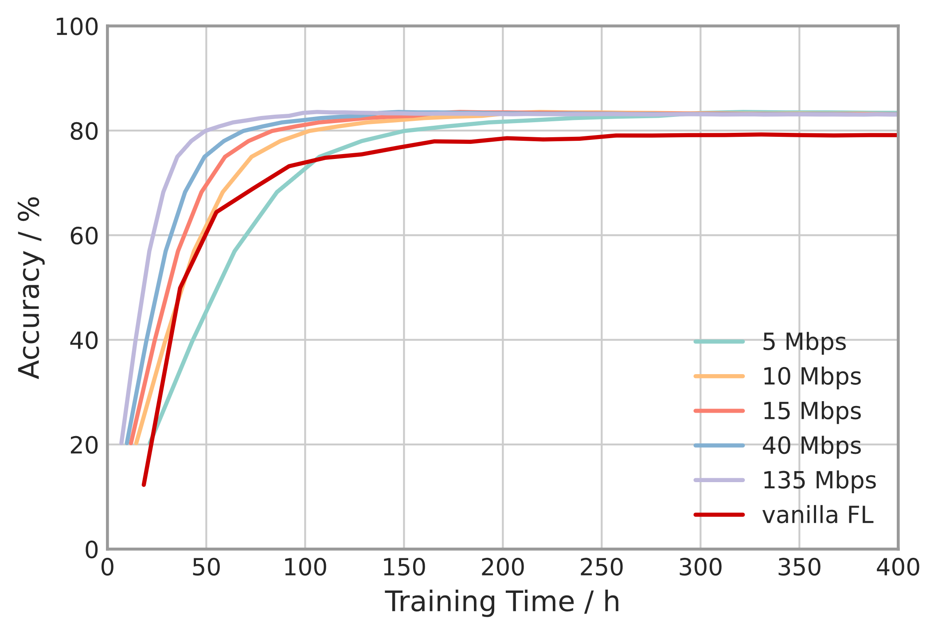
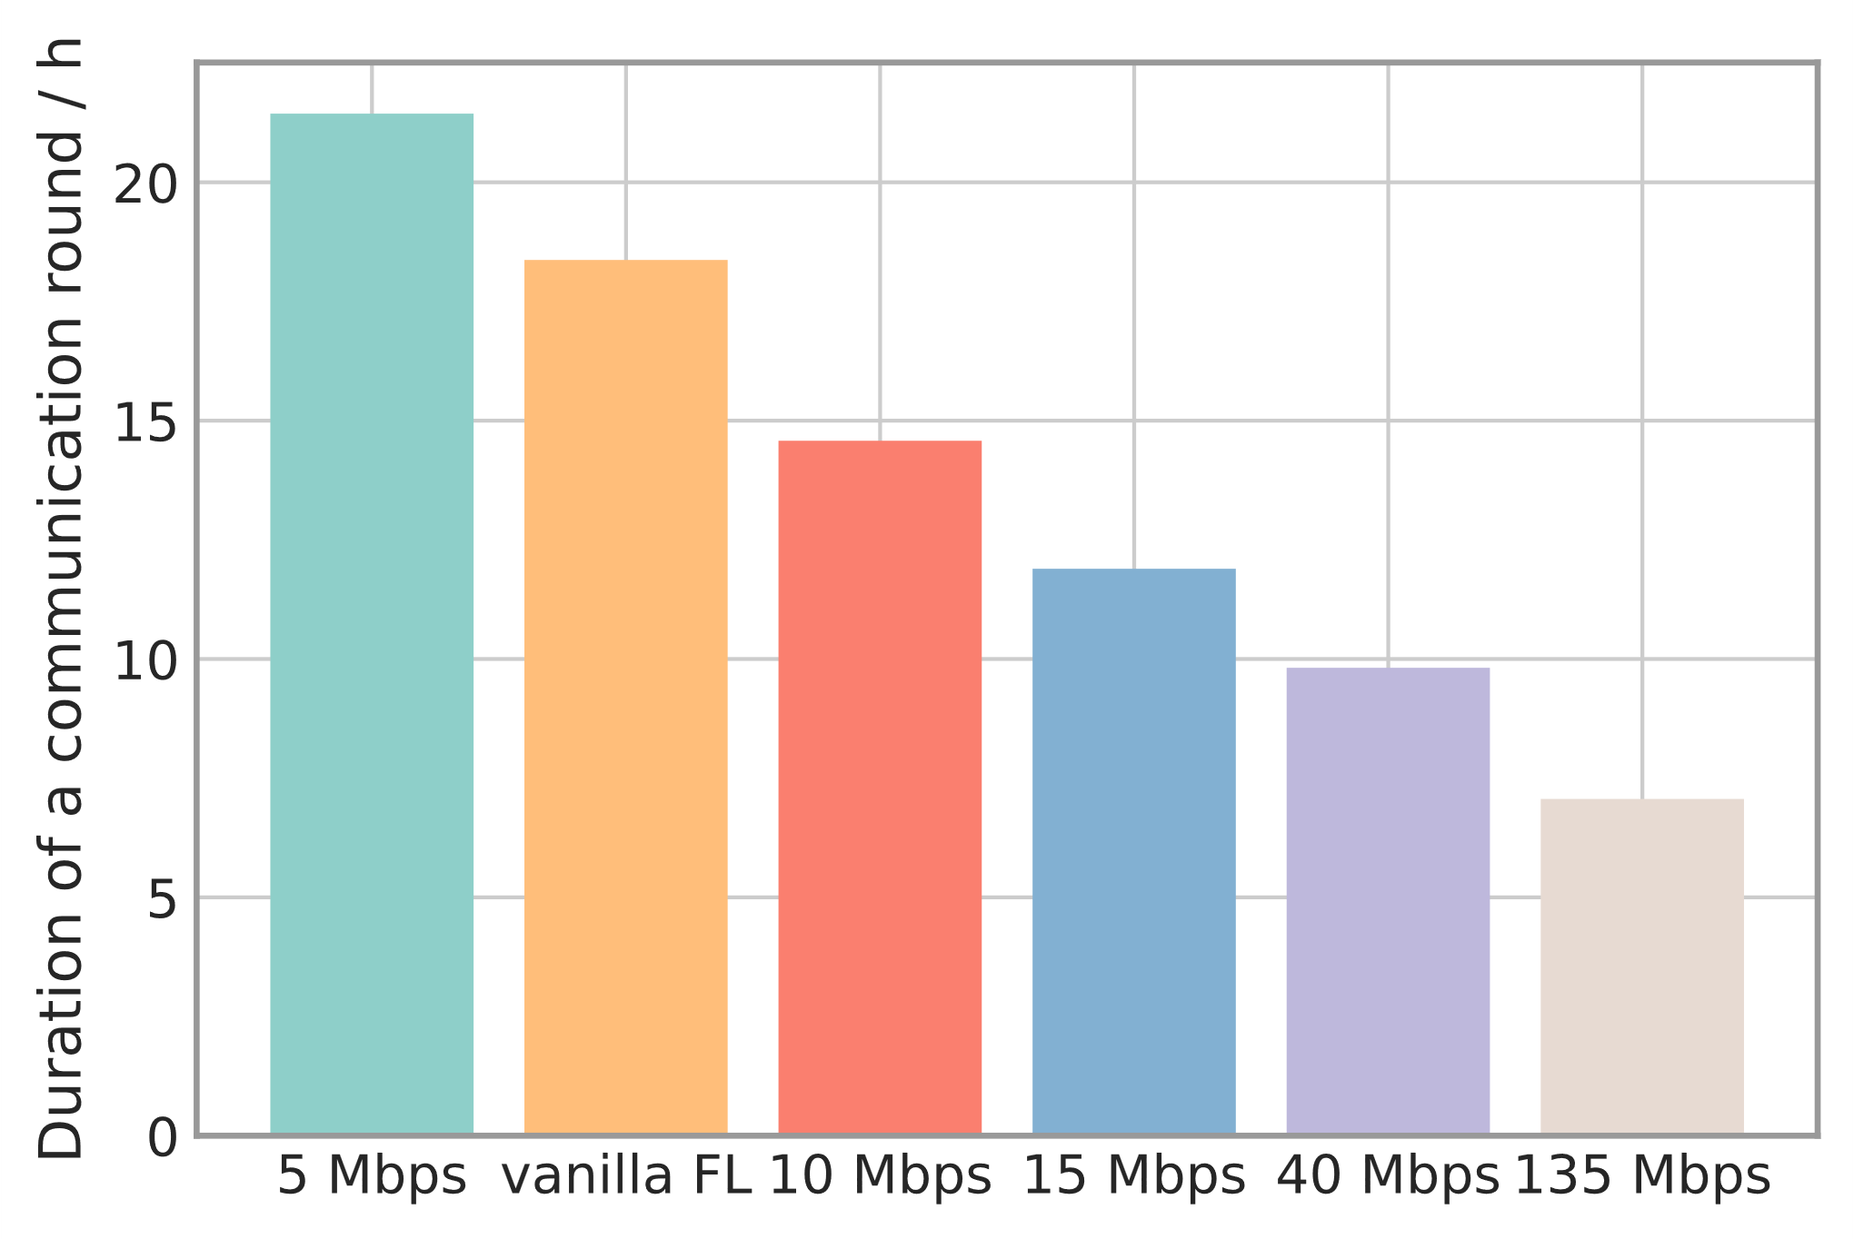
Results and Discussion
Background
RingSFL
Evaluation
-
Effect of D2D Communication
Testing convergence of ResNet18 on Cifar10 under different D2D communication rates.
Time cost of ResNet18 in a communication round under different D2D communication rates.
Notes:
Parallelly training.

Slide 41
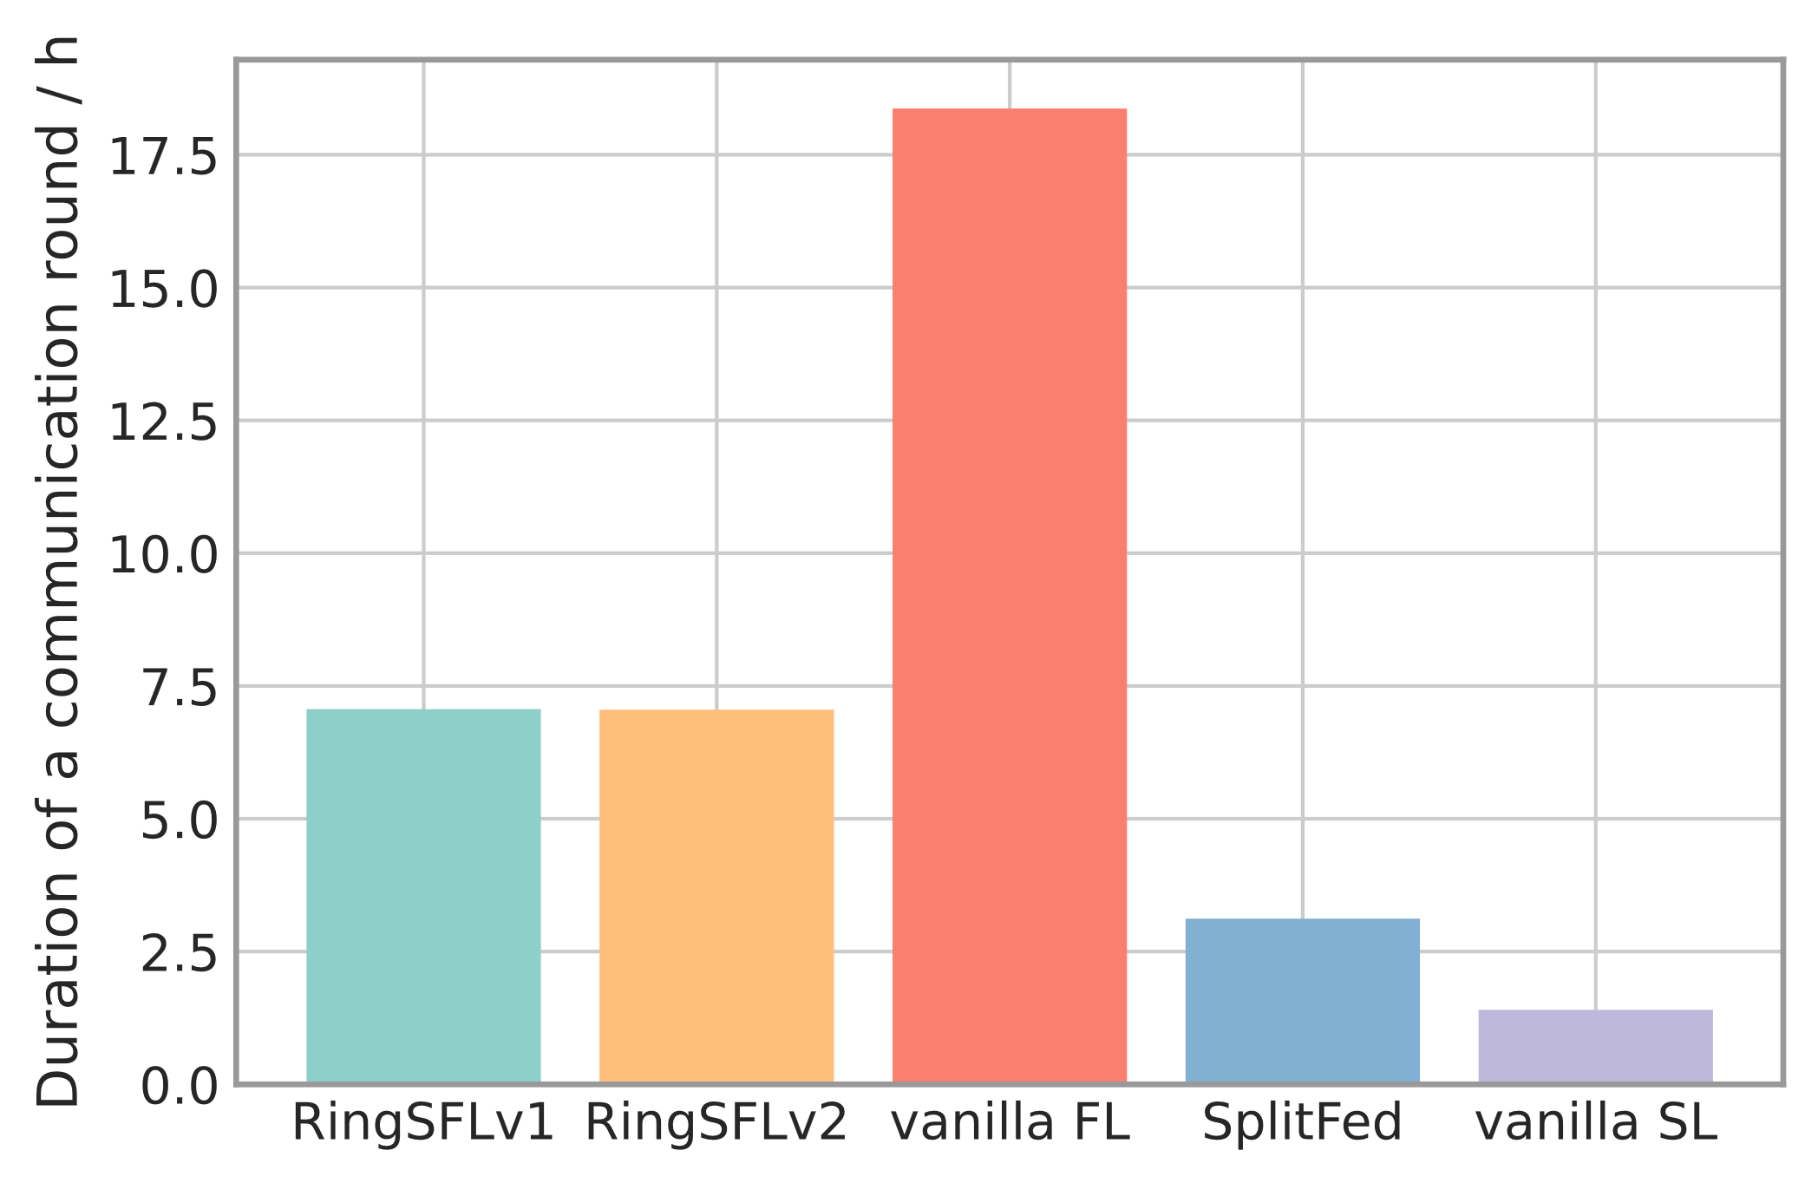
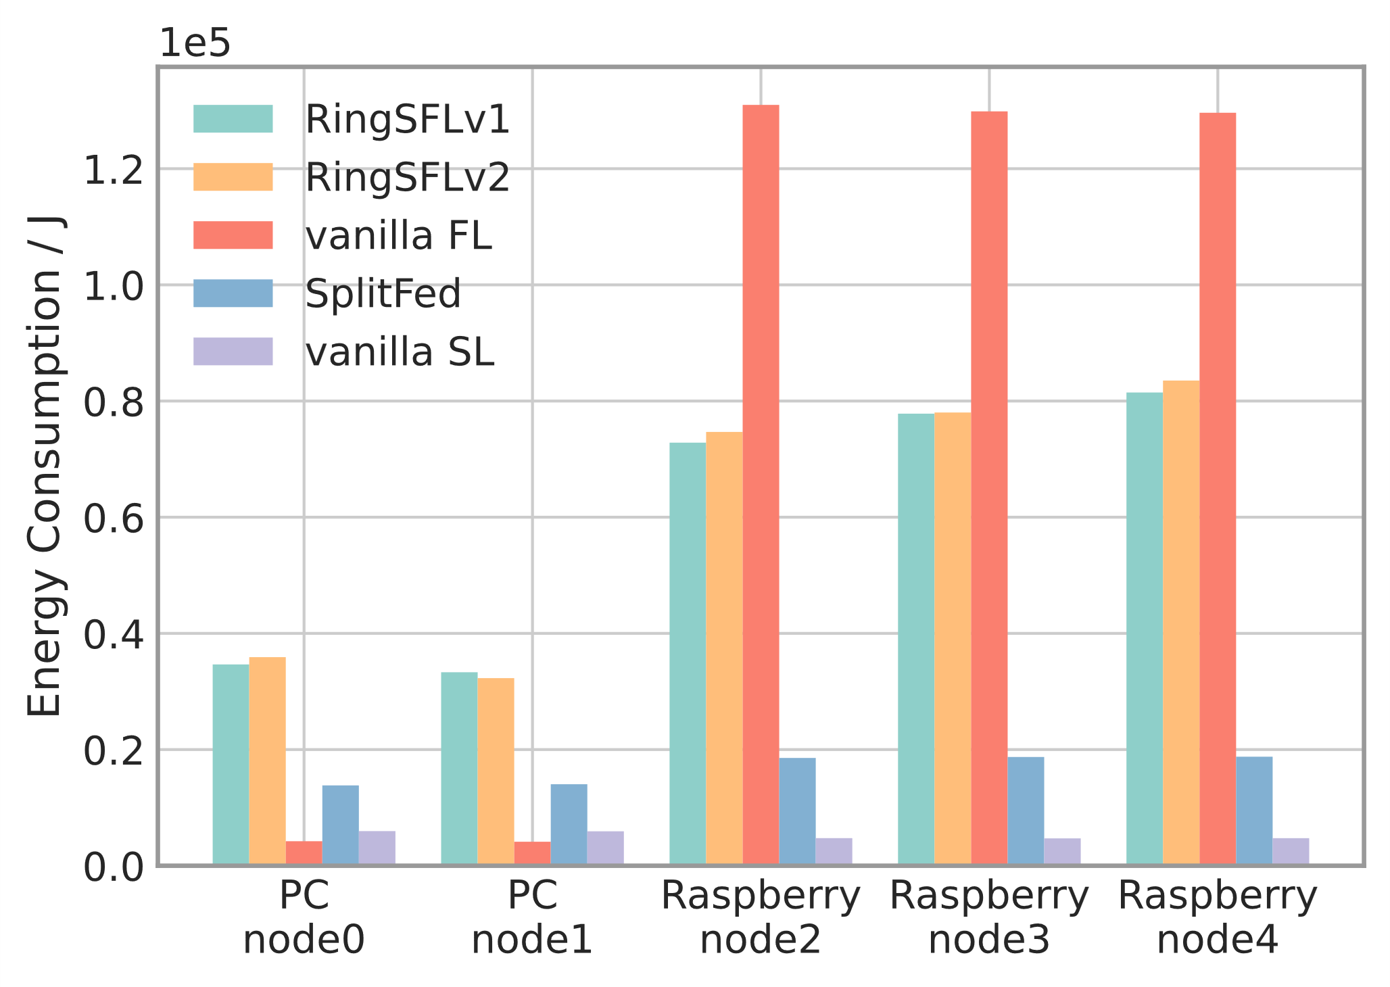
Results and Discussion
Background
RingSFL
Evaluation
-
Convergence Time Reduction and Energy Efficiency
Time cost of ResNet18 in a communication round under different algorithms.
Energy consumption of different devices in a communication round.
Notes:
Parallelly training.

Slide 42
Results and Discussion
Background
RingSFL
Evaluation
-
Convergence Time Reduction and Energy Efficiency
RingSFL
Vanilla FL
Notes:
Parallelly training.

Slide 43
THANK FOR ATTENTION
厚德 求真 励学 笃行

